Slide 1


Rayhan A. Bayuputra
September 10, 2024

Slide 2

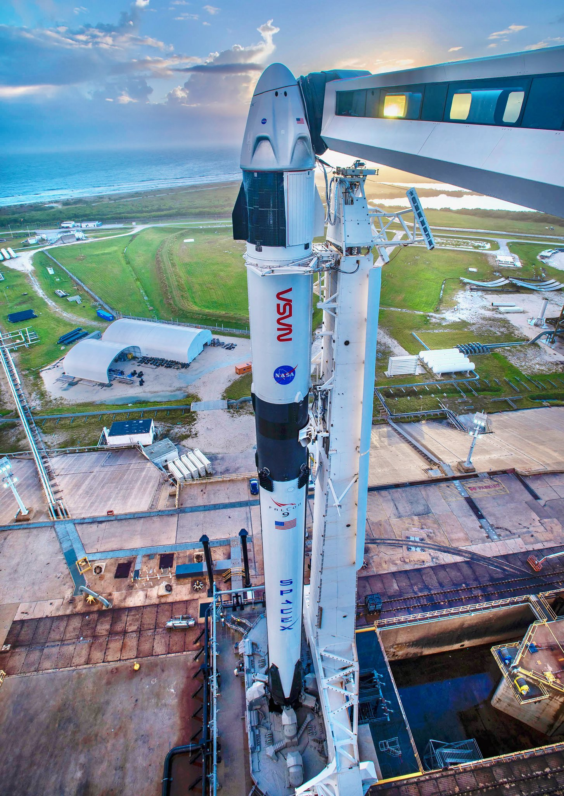
Outline
Executive Summary
Introduction
Methodology
Results
Conclusion
Appendix

Slide 3
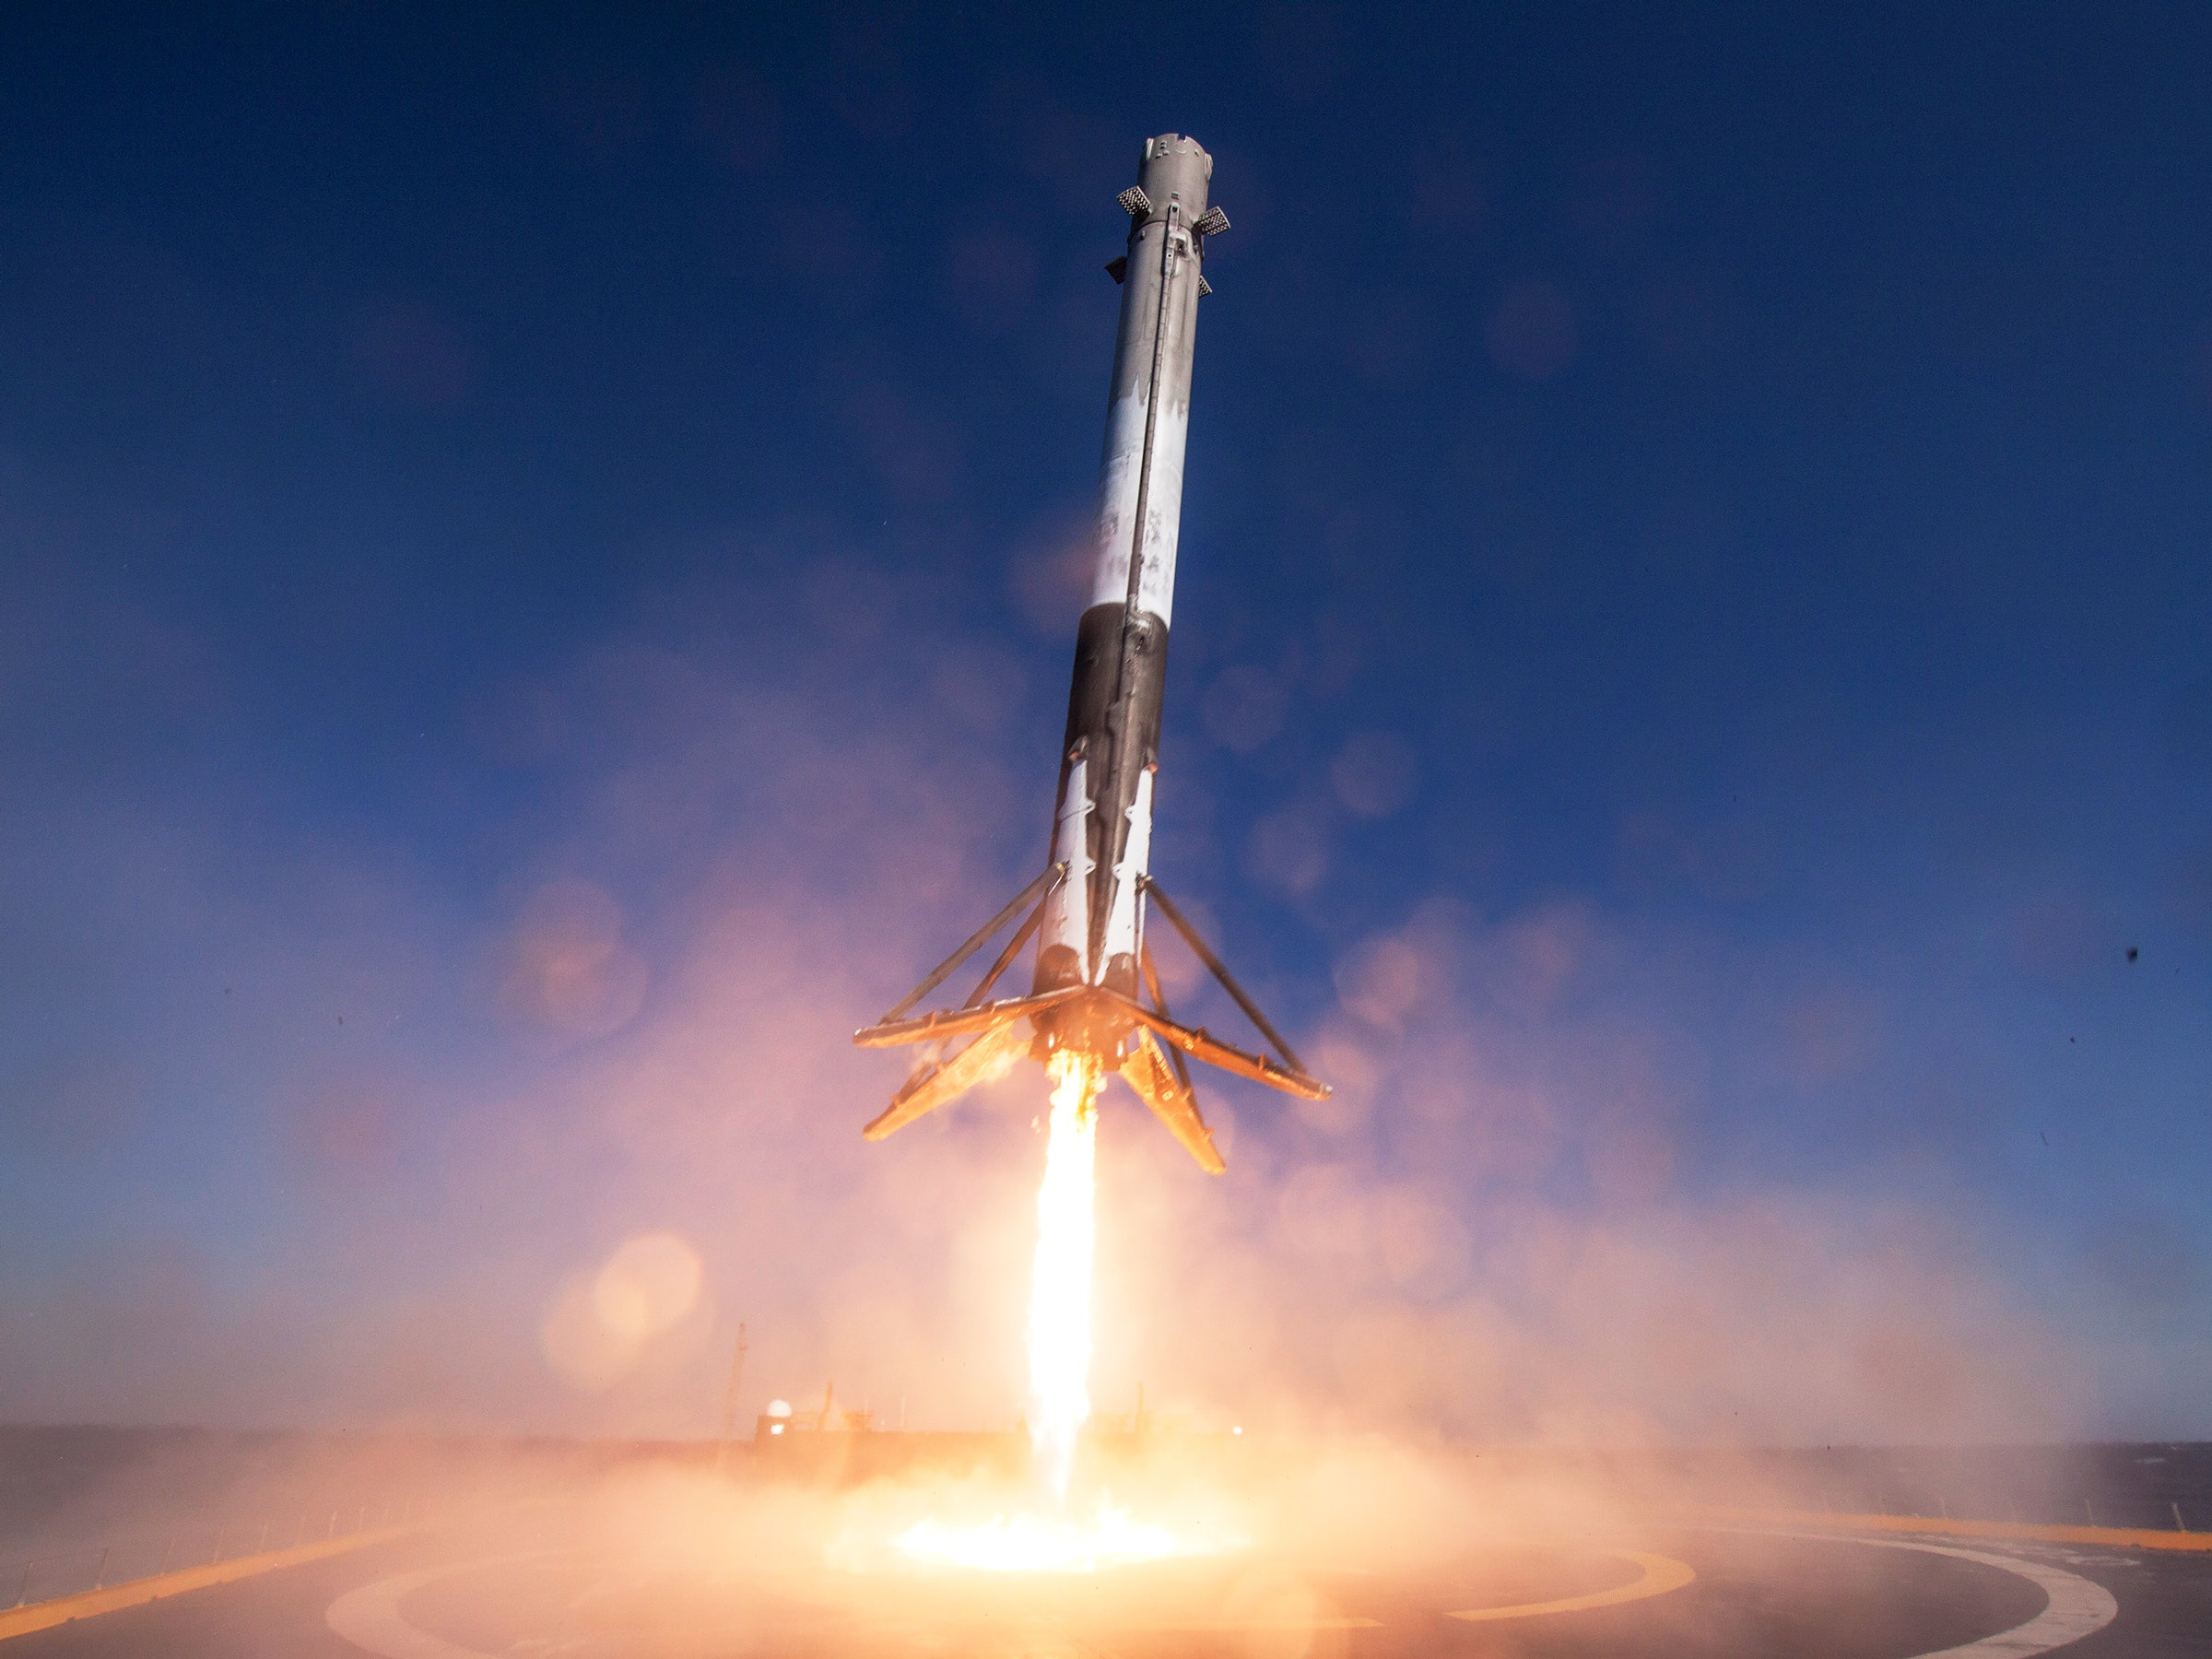
Executive Summary
This project aims to determine the successes of the rocket first stage landing successes, as well as the cost of a rocket launch for SpaceY, a rival company of SpaceX. Our company uses the SpaceX Falcon 9 rocket data in order to get answers to our objective.
Summary of methodologies
Data Collection
Data wrangling
Exploratory Data Analysis with Data Visualization and SQL
Building an Interactive Map with Folium
Building a Dashboard with Plotly Dash
Predictive Analysis
Summary of all results
Exploratory Data Analysis Results
Interactive Analytics Demo
Predictive Analysis Results

Slide 4
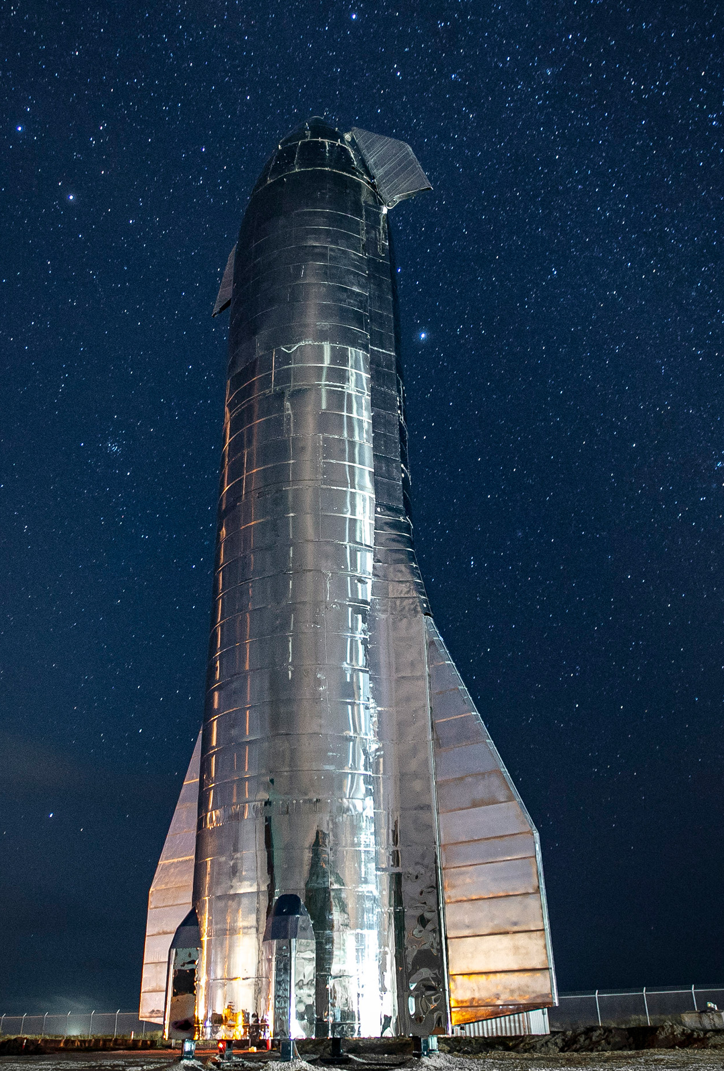
Introduction
This project seeks to analyze data from SpaceX Falcon 9 rocket launches to help SpaceY, a competitor, determine the factors contributing to the success of first-stage rocket landings and estimate the cost of a rocket launch. The analysis incorporates various methodologies such as data wrangling, visualization, and predictive modeling
We’re trying to find answers regarding:
What factors influence the success or failure of first-stage rocket landings?
How can we estimate the cost of rocket launches based on historical data?

Slide 5

Section 1

Slide 6
Methodology
Executive Summary
The data for this project was sourced from the SpaceX REST API and a Wikipedia launch table. The data wrangling process involved cleaning and preparing the data for visualization, as well as extracting relevant information for machine learning models like logistic regression, support vector machine (SVM), decision tree, and K-nearest neighbors (KNN).
Exploratory data analysis (EDA) was conducted using visualizations and SQL queries. Additionally, the Python libraries Folium and Plotly Dash were utilized to create interactive visualizations.
Finally, predictive analysis was carried out to forecast whether the Falcon 9 rocket’s first stage would successfully land, with model accuracy assessed using Scikit-learn.

Slide 7
Data Collection
The datasets were obtained from the SpaceX API and web scraping data from Wikipedia.
Collecting Data from SpaceX API
Process and filter data
Get insights
Web Scraping through Wikipedia

Slide 8
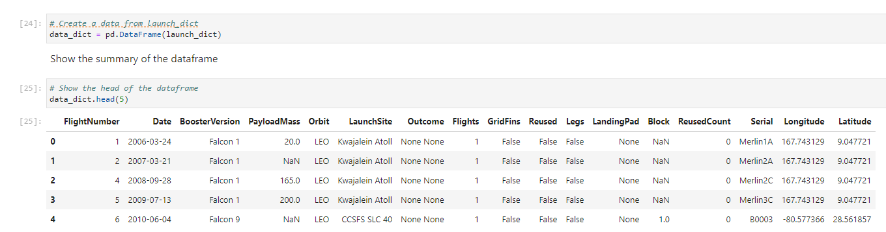
Data Collection – SpaceX API
We utilized the get request to the SpaceX API to collect data, clean the requested data and did some basic data wrangling and formatting.
Request data to the SpaceX API and gather the response in a variable
Clean data with custom functions
Process and filter data to only include Falcon 9 launches, then export the data to a csv file: dataset_part1
https://github.com/arvianta/coursera-ds-capstone/blob/main/notebook-checkpoints/1-jupyter-labs-spacex-data-collection-api.ipynb

Slide 9
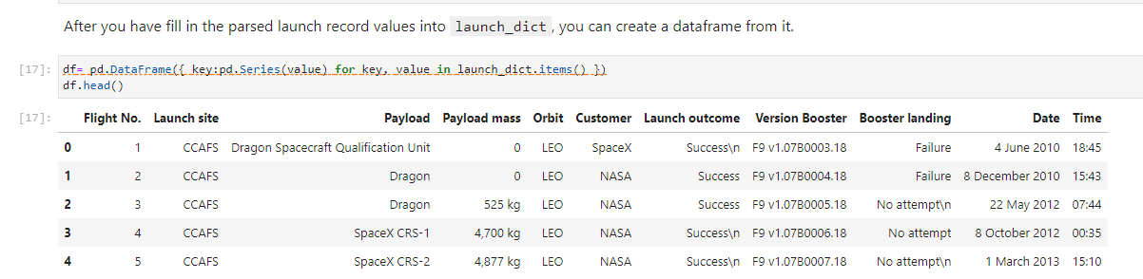
Data Collection - Scraping
We applied web scrapping to webscrap Falcon 9 launch records with BeautifulSoup
We parsed the table and converted it into a pandas dataframe.
Perform HTTP get to request Falcon 9 HTML page and create Beautiful Soup object from HTML
Extract all column/variable names from the HTML table header
https://github.com/arvianta/coursera-ds-capstone/blob/main/notebook-checkpoints/2-jupyter-labs-webscraping.ipynb
Create a data frame by parsing the launch HTML tables, export to CSV

Slide 10

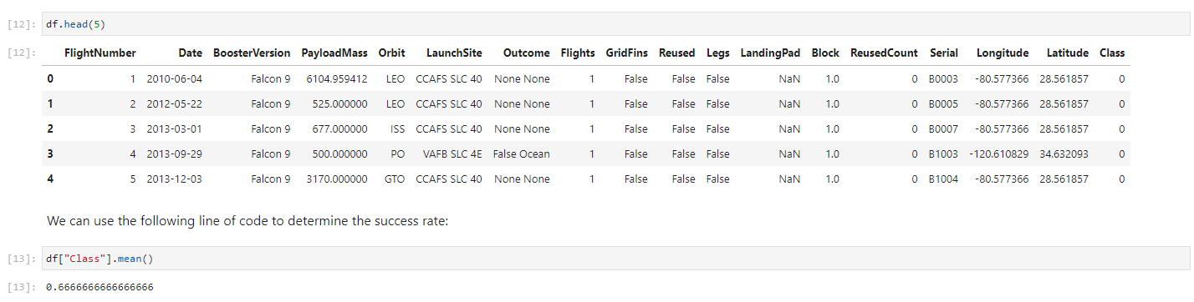
Data Wrangling
We performed exploratory data analysis and determined the training labels, calculated number of launches in each site, then store outcomes in a csv file.
Load data from dataset_part1 and calculate the number of launches on each site
Calculate the number and the occurrence of each orbits
https://github.com/arvianta/coursera-ds-capstone/blob/main/notebook-checkpoints/3-jupyter-labs-spacex-Data%20wrangling.ipynb
Calculate the number and occurrence of mission outcomes for each orbits

Slide 11
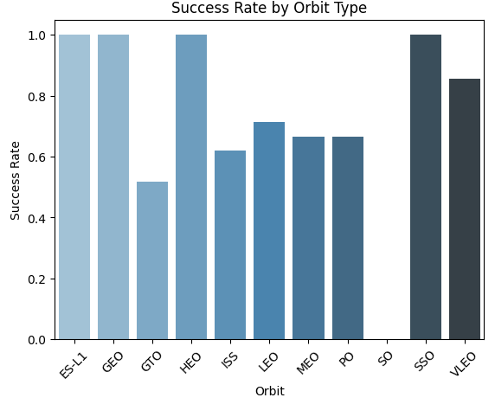
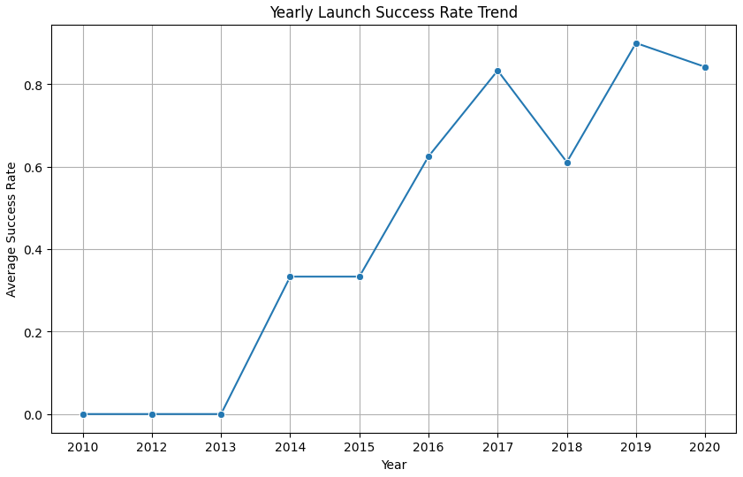
EDA with Data Visualization
We visualized the relationships between flight number and launch site, payload mass and launch site, success rate of each orbit type, flight number and orbit type, payload mass and orbit type, and success yearly trend.
https://github.com/arvianta/coursera-ds-capstone/blob/main/notebook-checkpoints/4-jupyter-labs-eda-py.ipynb

Slide 12
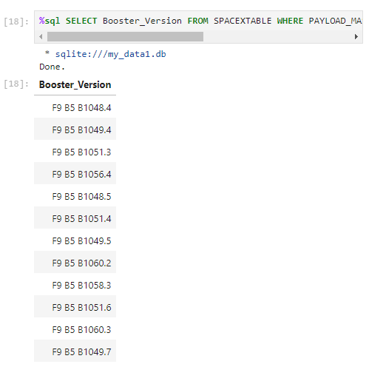
EDA with SQL
We did EDA with SQL to explore the data by looking at:
The names of the unique launch sites in the space mission
5 records where launch sites begin with the string 'CCA’
The total payload mass carried by boosters launched by NASA (CRS)
Average payload mass carried by booster version F9 v1.1
The dates when the first successful landing outcome in ground pad was acheived.
The names of the boosters which have success in drone ship and have payload mass greater than 4000 but less than 6000
The total number of successful and failure mission outcomes
The names of the booster_versions which have carried the maximum payload mass.
The records which will display the month names, failure landing outcomes in drone ship, booster versions, launch site for the months in year 2015
The count of landing outcomes (such as Failure (drone ship) or Success (ground pad)) between the date 2010-06-04 and 2017-03-20, in descending order.
https://github.com/arvianta/coursera-ds-capstone/blob/main/notebook-checkpoints/5-jupyter-labs-eda-sql-coursera_sqllite.ipynb

Slide 13
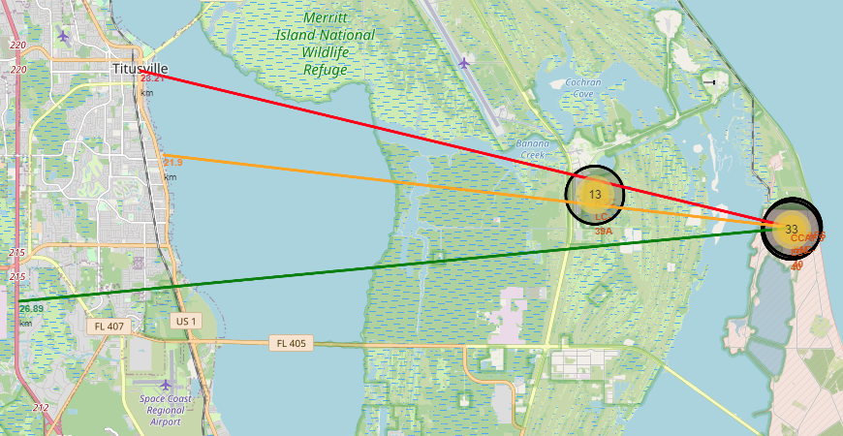
Build an Interactive Map with Folium
We marked all launch sites, and added map objects such as markers, circles, lines to mark the success or failure of launches for each site on the folium map.
We assigned the feature launch outcomes (failure or success) to class 0 and 1.i.e., 0 for failure, and 1 for success.
Using the color-labeled marker clusters, we identified which launch sites have relatively high success rate.
We calculated the distances between a launch site to its proximities. We answered some question for instance:
Are launch sites near railways, highways and coastlines.
Do launch sites keep certain distance away from cities.
https://github.com/arvianta/coursera-ds-capstone/blob/main/notebook-checkpoints/6-jupyter-labs_launch_site_location.ipynb

Slide 14
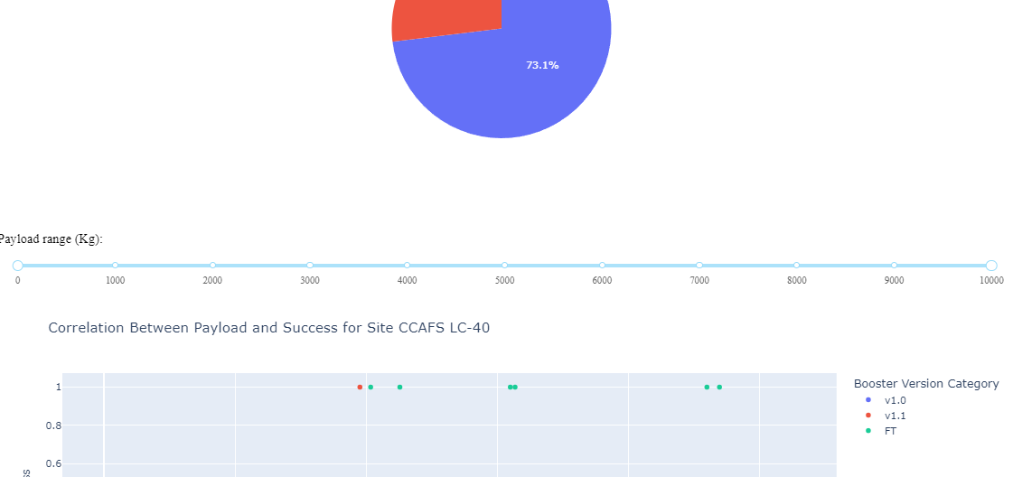
Build a Dashboard with Plotly Dash
We built an interactive dashboard with Plotly dash
We plotted pie charts showing the total launches by a certain sites
We plotted scatter graph showing the relationship with Outcome and Payload Mass (Kg) for the different booster version.
https://github.com/arvianta/coursera-ds-capstone/blob/main/spacex_dash_app.py

Slide 15
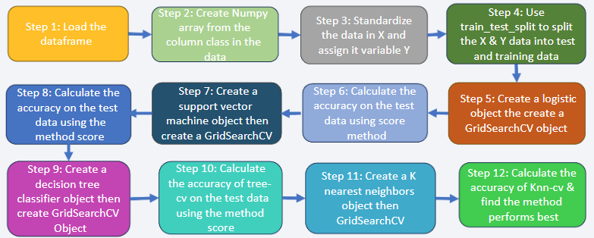
Predictive Analysis (Classification)
We loaded the data using numpy and pandas, transformed the data, split our data into training and testing.
We built different machine learning models and tune different hyperparameters using GridSearchCV.
We used accuracy as the metric for our model, improved the model using feature engineering and algorithm tuning.
We found the best performing classification model.
https://github.com/arvianta/coursera-ds-capstone/blob/main/notebook-checkpoints/7-SpaceX_Machine_Learning_Prediction.ipynb

Slide 16
Results
Exploratory data analysis results
Interactive analytics demo in screenshots
Predictive analysis results

Slide 17

Section 2

Slide 18
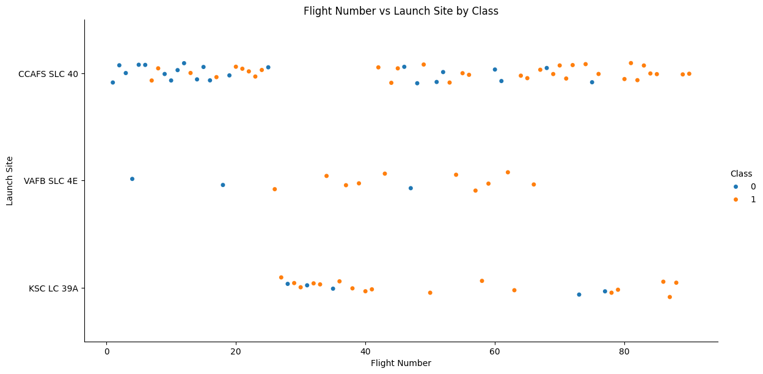
Flight Number vs. Launch Site
The majority of the flights were launched from the CCAFS SLC 40 site.
The VAFB SLC 4E and KSC LC 39A sites have higher success rate than other sites
Newer flights have higher success rates than the older ones.

Slide 19
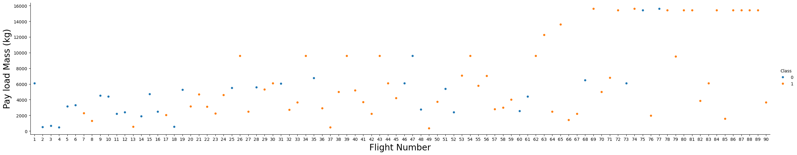
Payload vs. Launch Site
The majority of the flights with payload mass above 7000 Kg were successful.
KSC LC 39A success rate for payload mass under 5500 kg is 100%.
For all launch sites the success rate is proportional to the payload mass.

Slide 20
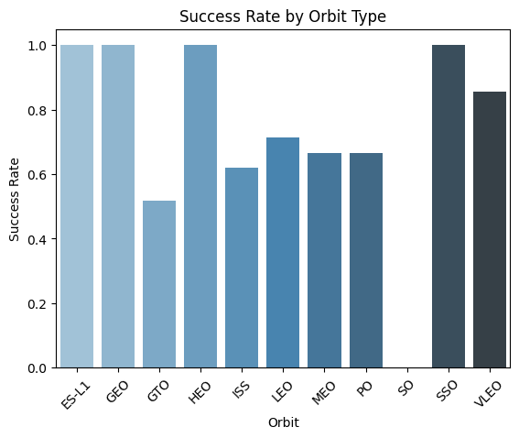
Success Rate vs. Orbit Type
The OS orbit has 0% success rate.
The ELS-1, GEO, HEO and SSO orbits have 100% success rate.
Orbits GTO, ISS, LEO, MEO and PO success rate is in between 50% and 75%

Slide 21
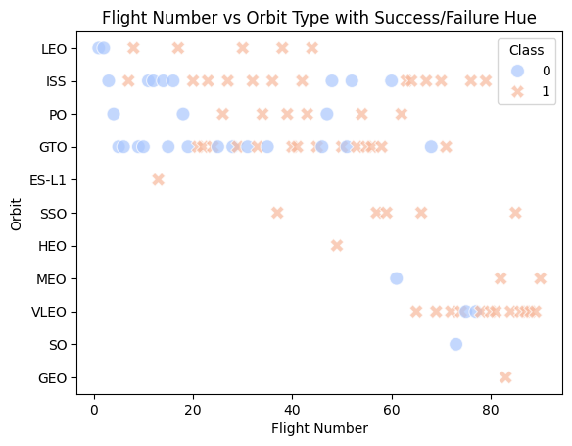
Flight Number vs. Orbit Type
The majority of the flights were launches to the ISS and GTO orbits.
The data suggests that there is no relationship between the flight number and the orbit type.

Slide 22
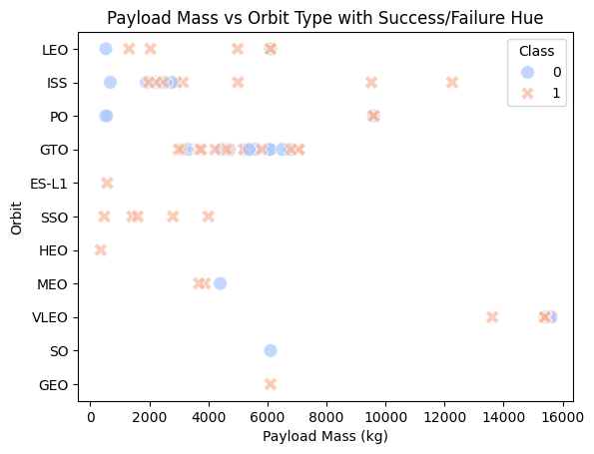
Payload vs. Orbit Type
Payloads that exceeds 10000kgs were placed in the VLEO and ISS orbits
Payloads that are lighter than 10000kgs scattered randomly, but avoids the VLEO orbit.

Slide 23
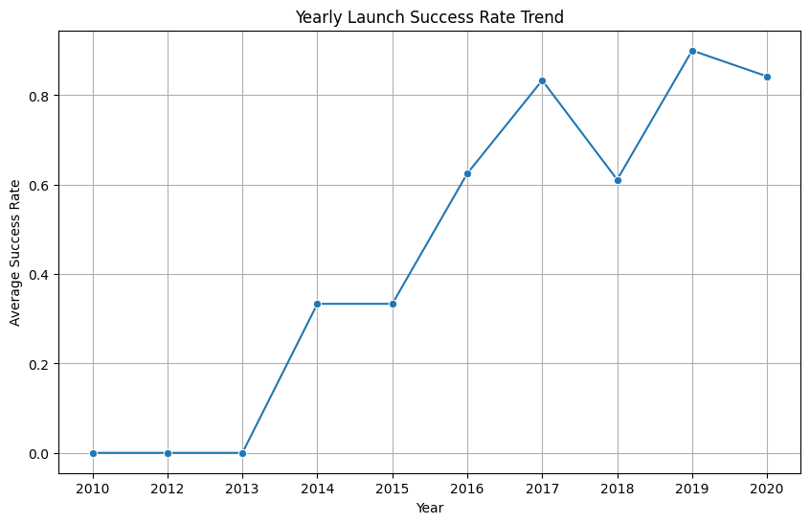
Launch Success Yearly Trend
The launches success rate increased steadily since 2013.
The increase in the success rate between 2013 and 2017 was linear.
During 2018 there was a drop in the launches success rate, before climbing back up in 2019

Slide 24
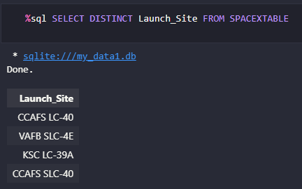
All Launch Site Names
We used the key word DISTINCT to show only unique launch sites from the SpaceX data.

Slide 25
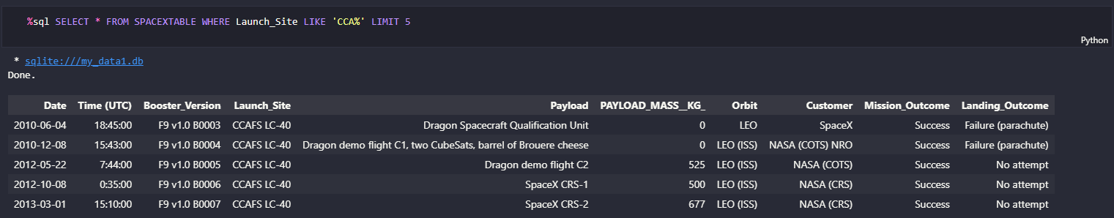
Launch Site Names Begin with 'CCA'
We used the query below to display 5 records where launch sites begin with `CCA`

Slide 26
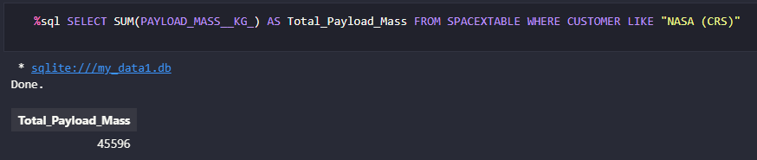
Total Payload Mass
The calculated total payload mass carried by boosters from NASA site is 45596 Kg.
The query used to obtain the total data uses the SUM function

Slide 27
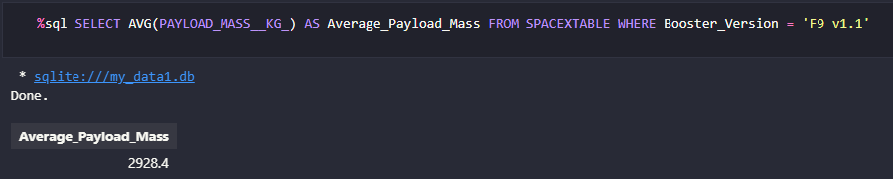
Average Payload Mass by F9 v1.1
We calculated the average payload mass carried by booster version F9 v1.1 as 2928.4

Slide 28
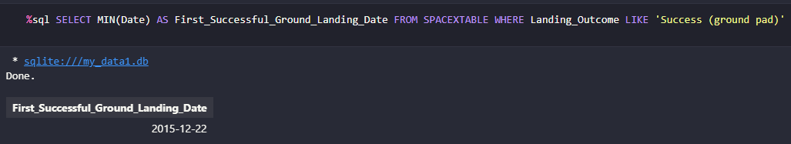
First Successful Ground Landing Date
We observed that the dates of the first successful landing outcome on ground pad was 22nd December 2015

Slide 29
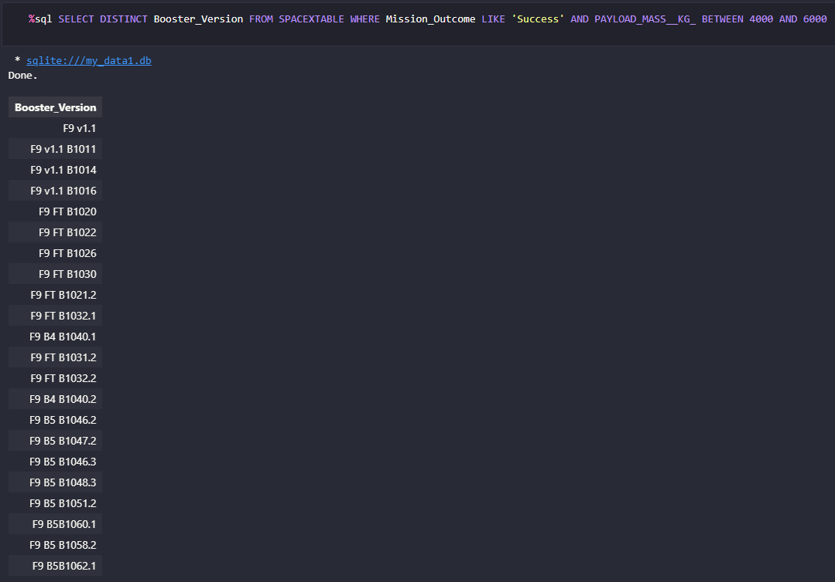
Successful Drone Ship Landing with Payload between 4000 and 6000
List of boosters which have successfully landed on drone ship and had payload mass greater than 4000 but less than 6000 is shown here.
We used the BETWEEN clause to obtain the data.

Slide 30
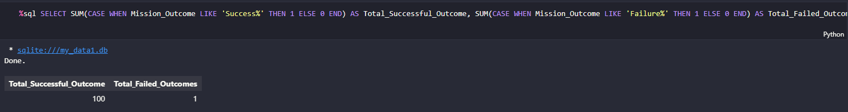
Total Number of Successful and Failure Mission Outcomes
We used wildcard like ‘%’ to filter out the data.
It shows that there are 100 total successful missions and only 1 failure.

Slide 31
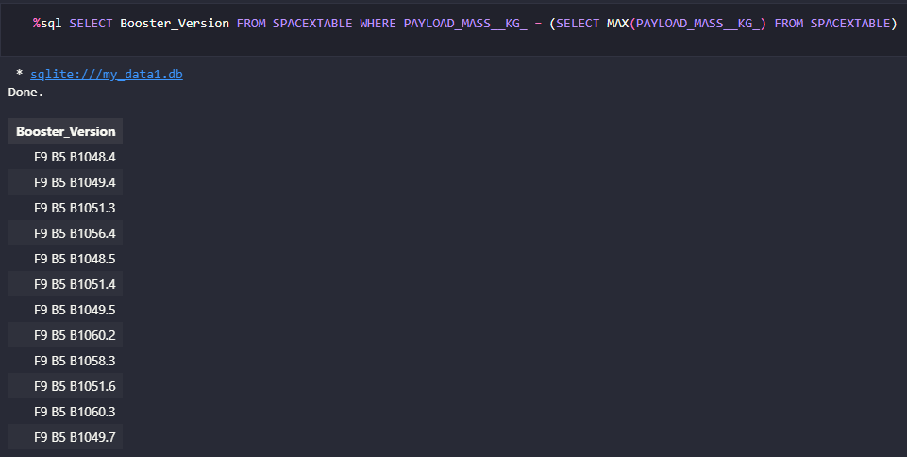
Boosters Carried Maximum Payload
Here we obtained several boosters that carried maximum payload, utilizing sql subqueries.

Slide 32
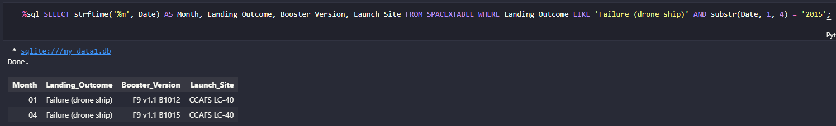
2015 Launch Records
Here are the list of failed landing_outcomes in drone ship, their booster versions, and launch site names for in year 2015.
Since SQLLite does not support monthnames, we accessed it through the Date substring.

Slide 33
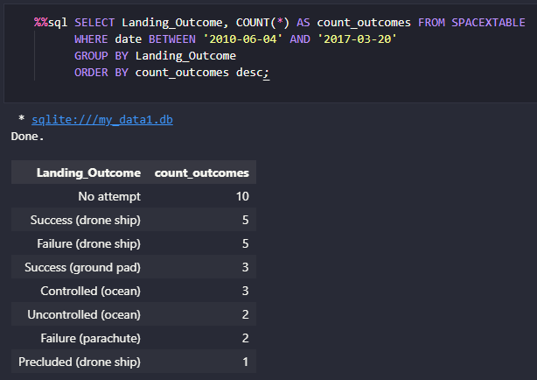
Rank Landing Outcomes Between 2010-06-04 and 2017-03-20
We selected Landing outcomes and the COUNT of landing outcomes from the data and used the WHERE clause to filter for landing outcomes BETWEEN 2010-06-04 to 2010-03-20.
We applied the GROUP BY clause to group the landing outcomes and the ORDER BY clause to order the grouped landing outcome in descending order.

Slide 34

Section 3

Slide 35
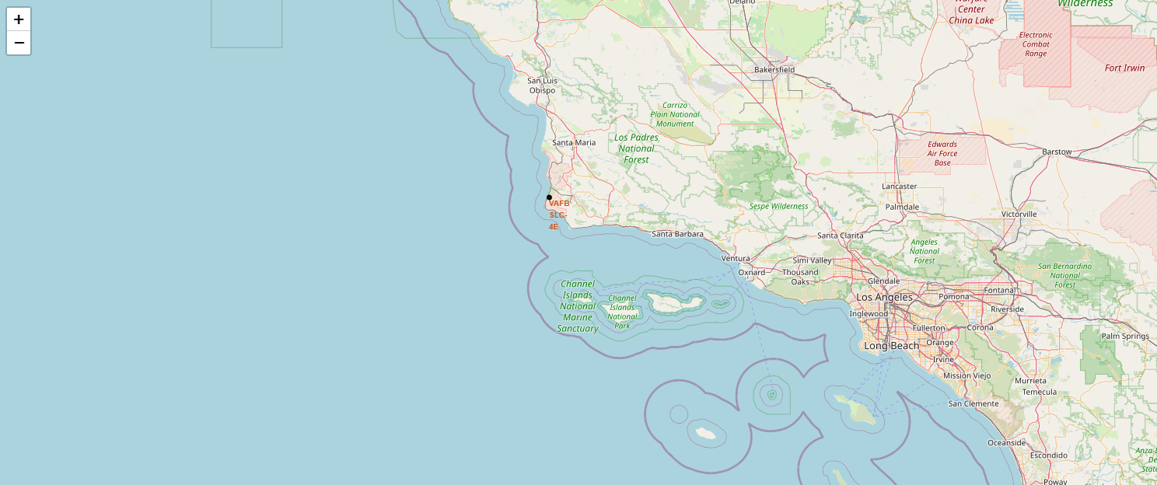
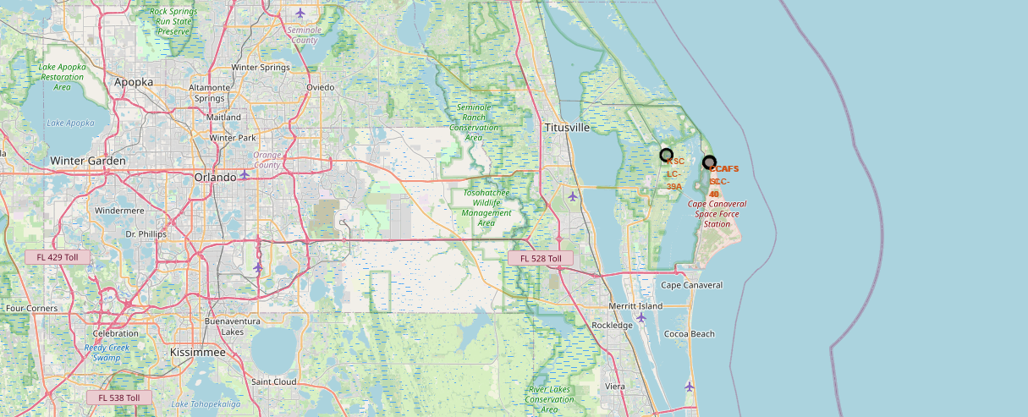
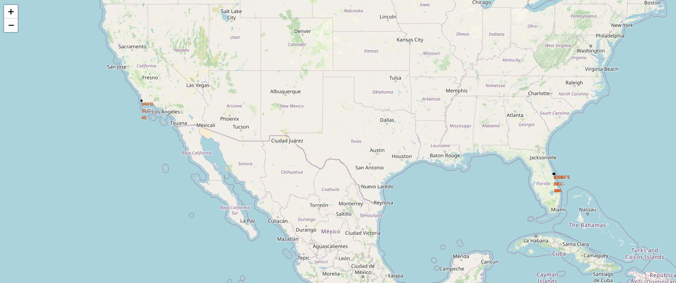
USA Launch Sites, California and Florida
Most of the launch sites considered in this project are in proximity to the equator line, making it moving at the maximum speed rather than other objects far from the equator line.
All launch sites featured are also very close to the coast, maximizing safety and minimizing the possibility of debris striking populated areas.

Slide 36

Markers showing launch sites with color labels

Slide 37
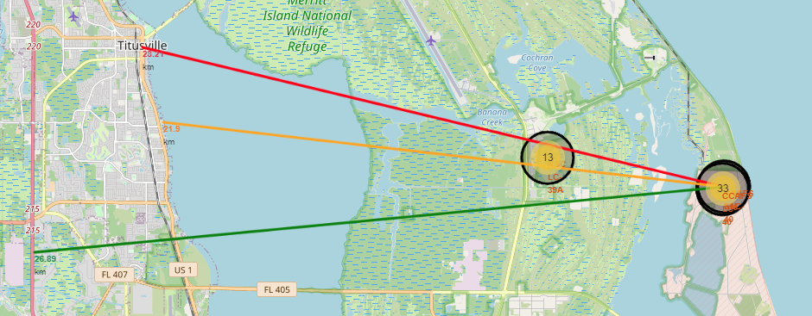
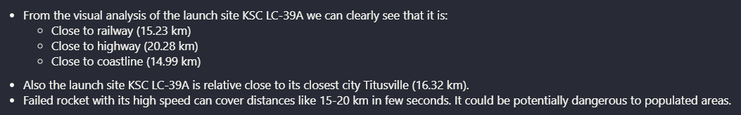
Launch Site Distance to Landmarks

Slide 38

Section 4

Slide 39

Total Launch Success for All Sites

Slide 40

Launch Site with the Highest Launch Success Ratio

Slide 41

Payload vs Launch Outcomes for All Sites

Slide 42

Section 5

Slide 43
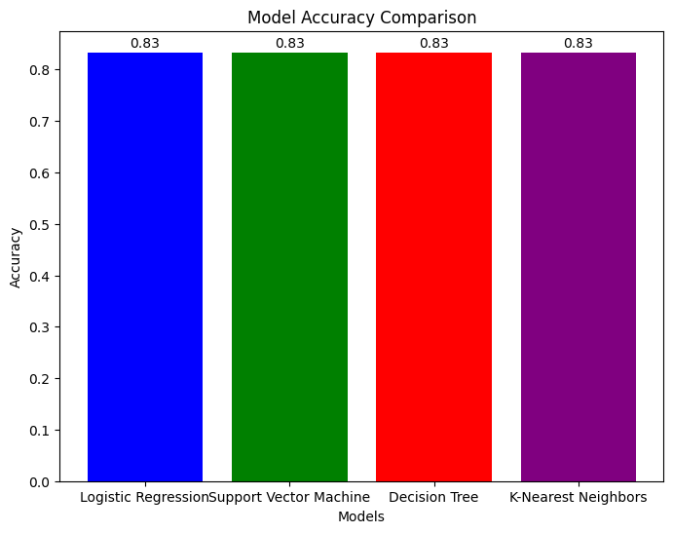
Classification Accuracy
All of the models have similar accuracy in comparison for this case with the given dataset.

Slide 44

Confusion Matrix
It is also shown in the 4 identical confusion matrix.

Slide 45
Conclusions
We can conclude that:
The larger the flight amount at a launch site, the greater the success rate at a launch site.
Launch success rate started to increase in 2013 till 2020.
Orbits ES-L1, GEO, HEO, SSO, VLEO had the most success rate.
KSC LC-39A had the most successful launches of any sites.
All of the machine learning algorithm have similar accuracies.

Slide 46
Appendix
https://github.com/arvianta/coursera-ds-capstone
https://www.coursera.org/learn/applied-data-science-capstone/home/module/1

Slide 47


